Slide 1
Safe Ministry Update
August 2020

Slide 2
Our Safe Ministry Program exists to ensure that our church environments, our spaces, our leaders and our culture are safe for all.

Slide 3
Legislation South Australia and Anglican Church
Child Safety (Prohibited Persons) Act 2016 & Regulations
Children and Young People (Safety) Act 2017 & Regulations
Civil Liability (Institutional Child Abuse Liability) Amendment Bill 2020.
Safe Ministry to Children Canon 2017
Safe Ministry Policy (Anglican Diocese of Adelaide) 2020
Episcopal Standards (Child Protection) Canon 2017
National Register Canon 2007 (Updated 2017)

Slide 4
Key Changes:
New Policy
New Training
Revision to roles requiring WWCC
Reference Checking
Obligations on Parishes:
Safe Ministry Co-Ordinator
Monthly Reporting
New Posters

Slide 5
Safe Ministry Policy - 2020
Safe Ministry Policy
Diocesan Council approved Safe Ministry policy sets out:
our vision;
our commitments; and
the responsibilities for each participant at the Diocesan level and the Parish level.
The Safe Ministry Policy for the Diocese is available at https://adelaideanglicans.com/safe-ministry/safe-ministry-resources/

Slide 6
Safe Ministry Compliance
Standards of Behaviour – no change: Faithfulness in Service
Training: State and Church educational requirements
Screening and Selection: Identifying and assessing safe ministry compliance
Notes:
Introducing Session 2

Slide 7
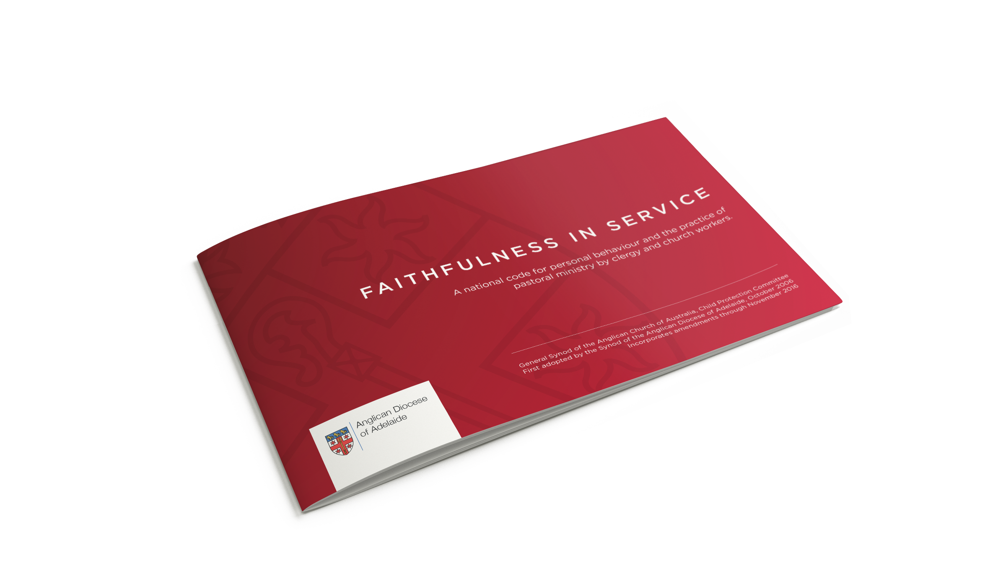
The Diocesan Code of Conduct
‘Faithfulness in Service’
A national code of conduct for personal behaviour and the practice of pastoral ministry by clergy and church workers formulated by the Anglican Church of Australia
Adopted by the Synod of the Anglican Diocese of Adelaide in 2006, and revised since, it provides a framework for transparency and accountability.
The code identifies personal behaviour and practises of pastoral ministry which will ensure safe church communities.
Notes:
All people seeking an Archbishop’s licence assent to this document.
Category of compliance required depends on the ministry position you hold
This document – pioneered in SA in 2006 – has been revised for some other parts of the national church is the Church’s official expression of our belief and belonging in order to provide a guide for our behaviour.
Ministry is not less than, but more than legal observance of document
All members of the Anglican Church in this Diocese must be familiar with and uphold the ethos of this document. We are all called to implement this Code of Conduct in a spirit of prayerfulness, love, and respect empowered by the Holy Spirit.
It is only through the attitudes and actions of each of us that the integrity of Church communities can be upheld.

Slide 8
Safe Ministry Compliance
Standards of Behaviour: Faithfulness in Service
Training: State and Church educational requirements
Screening and Selection: Identifying and assessing safe ministry compliance

Slide 9
Training
Totally online – videos and Questionnaires
Delivered by Safe Ministry Check, & developed in partnership with Ansvar Risk Insurance.
Required in addition to a Working With Children Check compliance
Includes on line ESCC
Refresh every three years

Slide 10
Safe Ministry Compliance
Standards of Behaviour: Faithfulness in Service
Training: State and Church educational requirements
Screening and Selection: Identifying and assessing safe ministry compliance

Slide 11
Roles that must obtain a safe ministry clearance:
All clergy and lay persons holding an authority from the Bishop
All candidates for Ordination
All lay church workers in paid employment involving work with children
All lay volunteers who work with children
All members of Diocesan Council
Members of Parish Councils only where the Parish concerned has lay paid staff or volunteers who work with children.

Slide 12
No requirement for WWCC
a person will not be performing 'child-related work' if they are performing 'any other service or activity' in the course of which contact with children occurs incidentally or would not reasonably be expected to occur.
a person who believes on reasonable grounds that they will not 'work with children' on more than seven days in a calendar year
This means that if your church does not have a children’s program or youth group, the only persons required to hold a WWCC are the clergy.
WWCC Required Checklist on website, Synod Office will assist.

Slide 13
Reference Checking
Required by Safe Ministry To Canon 2017
Email with three simple questions to nominated referees
Any concerns will raise red flag for further follow up
Integrated with Safe Ministry System on Salesforce

Slide 14
Safe Ministry Coordinator
The Safe Ministry Policy creates a new position: a Safe Ministry Coordinator in each parish.
The Safe Ministry Coordinator helps the Parish to comply with the safe ministry requirements of the Diocese.
Assist the Parish Priest to comply with safe ministry screening requirements,
Keep records of Working With Children Checks and Safe Ministry training,
Monitor and Report on safe ministry systems and practices in the parish, and
Report any abuse.

Slide 15
A Safe Ministry Coordinator must
be 21 years or older;
hold a safe ministry clearance from the Diocese;
have an email account (for administrative purposes);
have good administrative skills; and
be capable of maintaining a computer spreadsheet.

Slide 16
Safe Ministry Co-Ordinator report
Lists all child related work activities for the month
Identifies which adults were involved
Specifies their WWCC status
Sent to Safe Ministry Unit monthly
Monitors those who are ‘working with children” without a WWCC

Slide 17
New Posters
Reflects updated Policy
Identifies the parish Safe Ministry Co-Ordinator
Lists names of people who hold a WWCC
Families must have certainty that those who are working with their children hold the appropriate clearance
Identifies how and where to make a complaint

Slide 18
The Diocese of Adelaide Professional Standards Process
Who is a Church Worker?
A person who is, or was at the time:
A member of Clergy
An employee of the Church Body
A person holding a position, or performing a function with, a Church Authority or member of a Church Body
Obligations
All Church Workers are required to contact the Professional Standards Director if they observe or are informed of misconduct by another Church Worker.
Notes:
The Professional director :
Provides advice about what must be reported
Provides advice about who must report
Provides advice about who to report to
Initiates the process that leads to investigation of allegations

Slide 19
Thank you & Questions
We pray that our belief in God will lead us, as Christian communities, to commit to the wellbeing of other people.
Notes:
FINAL PRAYER

